Slide 1
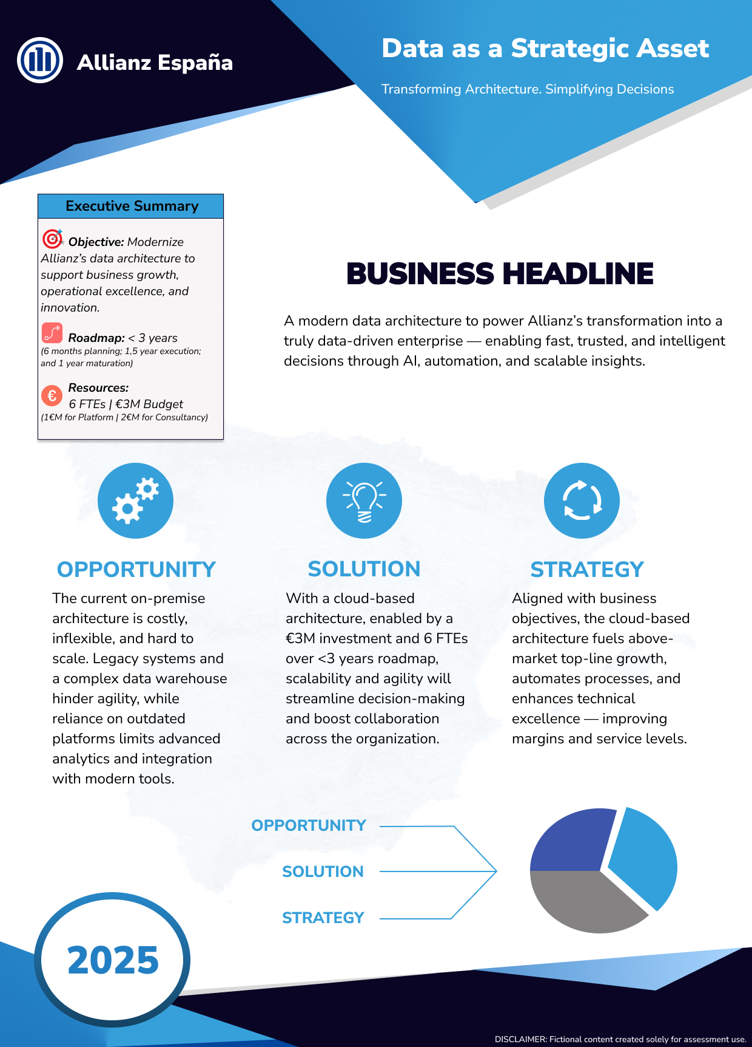
Notes:
One Pager (4 minutes)
Introduction This one-pager presents an overview of a strategic initiative titled "Data as a Strategic Asset – Transforming Architecture. Simplifying Decisions." It outlines how Allianz can modernize its data architecture to accelerate growth, enhance operational excellence, and foster innovation— aligned with the company's 2025 strategic goals.
The document is structured into the following sections: Executive Summary, Business Headline, Opportunity, Solution, and Strategy.
Executive Summary Over the Executive Summary, it’s possible the see the already mentioned objective, along with a roadmap and resources needed. The plan is structured over less than three years (6 months of planning, 1.5 years of execution, and a final year for system maturation). It is estimated a need for 6 FTEs and a €3 million budget (€1 million for platform investment and €2 million for consultancy support).
Business Headline Here, once again, I emphasize how good this whole transformation can be for the company.
Opportunity In terms of opportunities, today the companies rely an on-premises architecture, which is a major bottleneck. It is costly, inflexible, and difficult to scale. Legacy systems and an outdated data warehouse hinder agility, while reliance on old platforms limits the ability to adopt modern analytics and integration tools. This severely impacts the speed of decision-making and innovation potential.
Solution However, a problem cannot exist without its counterpart, a solution – and in this case, that comes as cloud-based architecture. By investing €3 million and mobilizing 6 FTEs, within 3 years, we can modernize, boost scalability, agility, and collaboration across the entire organization. This transformation will enable fast, trusted, and intelligent decision-making through AI, automation, and insights.
Strategy
Ensuring the solution also follows in line with the company’s strategy for 2025:
It will drive above-market growth.
It will automate processes and enhance technical excellence.
It will improve margins and service levels by making the organization more efficient, connected, and data-driven.
Closing
In short, this is not just a technological upgrade — it’s a business enabler. Modern data architecture will simplify decisions, fuel innovation, and position Allianz for the best.

